Slide 1
Computer Organization & Architecture
Bits, Data Types, and Operations
Chapter 2
Instructor: Dr. Baha Ihnaini

Slide 2
How do we represent data in a computer?
At the lowest level, a computer is an electronic machine.
Works by controlling the flow of electrons.
Easy to recognize two conditions:
Presence of a voltage – we’ll call this state “1.”
Absence of a voltage – we’ll call this state “0.”
We could base the state on the value of the voltage, but control and detection circuits are more complex.
Compare sticking a lightbulb (or your finger) in a socket versus using a voltmeter.

Slide 3

Computer is a Binary Digital system
Digital = finite number of values (compared to “analog” = infinite values) Binary = only two values: 0 and 1
Unit of information = binary digit, or “bit”
Circuits (see Chapter 3) will pull voltage down towards zero, or will pull up towards the highest voltage.
Grey areas represent noise margin -- allowable deviation due to resistance, capacitance, interference from other circuits, temperature, etc. More reliable than analog.

Slide 4
More than two values...
Each "wire" in a logic circuit represents one bit = 0 or 1.
Values with more than two states require multiple wires (bits).
With two bits, can represent four different values:
00, 01, 10, 11
With three bits, can represent eight different values:
000, 001, 010, 011, 100, 101, 110, 111
With n bits, can represent 2^{n} different values.

Slide 5
What kinds of values do we want to represent?
Numbers - integer, fraction, real, complex, ...
Text - characters, strings...
Images - pixels, colors, shapes...
Sound
Video
Logical - true, false
Instructions
All data is represented as a collection of bits.
We encode a value by assigning a bit pattern to represent that value.
We perform operations (transformations) on bits, and we interpret the results according to how the data is encoded.

Slide 6
Data Type
In a computer system, we need a representation of data and operations that can be performed on the data by the machine instructions or the computer language.
This combination of representation + operations is known as a data type.
Type | Representation | Operations
Unsigned integers | binary | add, multiply, etc.
Signed integers | 2's complement binary | add, multiply, etc.
Real numbers | I E E E floating-point | add, multiply, etc.
Text characters | A S C I I | input, output, compare

Slide 7
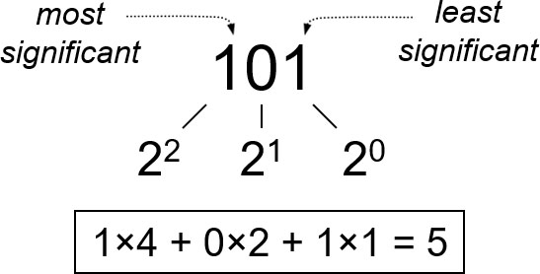
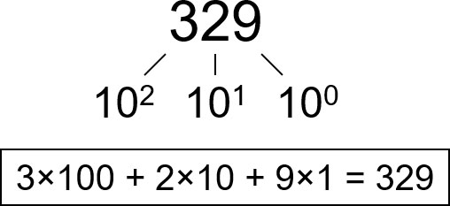
Unsigned Integers 1
Non-positional notation (unary)
Could represent a number (“5”) with a string of ones (“11111”).
Problems?
Weighted positional notation (binary)
Like decimal numbers: “329.”
“3” is worth 300, because of its position, while “9” is only worth 9.
Since only 0 and 1 digits, use a binary (base-two) number system.

Slide 8
Unsigned Integers 2
Encode a decimal integer using base-two binary number
Use n bits to represent values from 0 to

Slide 9
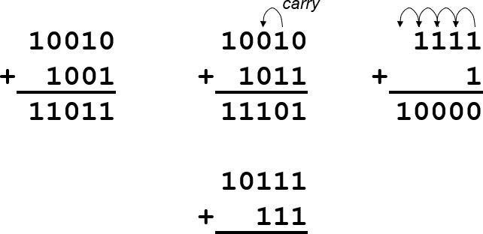
Unsigned Binary Arithmetic
Base-2 addition -- just like base-10
Add from right to left, propagating carry.
Can also do subtraction, multiplication, etc., using base-2.

Slide 10
Signed Integers
How to represent positive (+) and negative (−)?
With n bits, we have
encodings.
Use half of the patterns (the ones starting with zero) to represent positive numbers.
Use the other half (the ones starting with one) to represent negative numbers.
Three different encoding schemes
Signed-magnitude.
1's complement.
2's complement.

Slide 11
Signed-Magnitude
Leftmost bit represents the sign of the number.
0 = positive
1 = negative
Remaining bits represent the magnitude of the number using the binary notation used for unsigned integers.
Examples of 5-bit signed-magnitude integers:
00101 = +5 (sign = 0, magnitude = 0101)
10101 = −5 (sign = 1, magnigude = 0101)
01101 = +13 (sign = 0, magnitude = 1101)
10010 = −2 (sign = 0, magnitude = 0010)

Slide 12
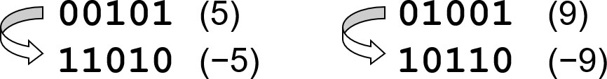
1's complement
To get a negative number, start with a positive number (with zero as the leftmost bit) and flip all the bits -- from 0 to 1, from 1 to 0.
Examples -- 5-bit 1's complement integers:

Slide 13
Disadvantages of Signed-Magnitude and 1's Complement
In both representations, two different representations of zero
Signed-magnitude: 00000 = 0 and 10000 = 0.
1's complement: 00000 = 0 and 11111 = 0.
Operations are not simple.
Think about how to add +2 and −3.
Actions are different for two positive integers, two negative integers, one positive and one negative.
A simpler scheme: 2's complement

Slide 14
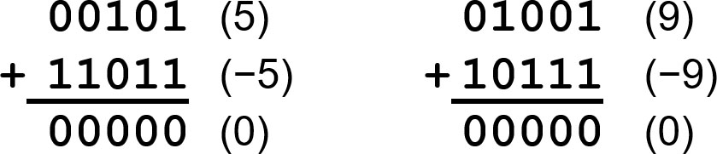
2's Complement
To simplify circuits, we want all operations on integers to use binary arithmetic, regardless of whether the integers are positive or negative.
When we add +X to −X we want to get zero.
Therefore, we use "normal" unsigned binary to represent +X. And we assign to −X the pattern of bits that will make X + (−X) = 0.
NOTE: When we do this, we get a carry-out bit of 1, which is ignored.
We only have 5 bits, so the carry-out bit is ignored and we still have 5 bits.

Slide 15
2's Complement Integers
4-bit 2's complement | value | 4-bit 2's complement | value
0000 | 0
0001 | 1 | 1111 | −1
0010 | 2 | 1110 | −2
0011 | 3 | 1101 | −3
0100 | 4 | 1100 | −4
0101 | 5 | 1011 | −5
0110 | 6 | 1010 | −6
0111 | 7 | 1001 | −7
 |  | 1000 | −8
With n bits, represent values from
NOTE: All positive number start with 0, all negative numbers start with 1.

Slide 16
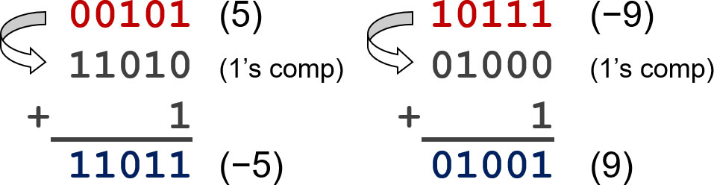
Converting X to −X
Flip all the bits. (Same as 1's complement.)
Add +1 to the result.
A shortcut method:
Copy bits from right to left up to (and including) the first '1'. Then flip remaining bits to the left.

Slide 17
Converting Binary (2's C) to Decimal
If leading bit is one, take two’s complement to get a positive number.
Add powers of 2 that have “1” in the corresponding bit positions.
If original number was negative, add a minus sign.
n | 2^{n}
0 | 1
1 | 2
2 | 4
3 | 8
4 | 16
5 | 32
6 | 64
7 | 128
8 | 256
9 | 512
10 | 1024
Examples use 8-bit 2’s complement numbers.
In the following table, read ‘2^{n}’ as 2 to the power n.

Slide 18
More Examples
n | 2^{n}
0 | 1
1 | 2
2 | 4
3 | 8
4 | 16
5 | 32
6 | 64
7 | 128
8 | 256
9 | 512
10 | 1024
In the following table, read ‘2^{n}’ as 2 to the power n.
Examples use 8-bit 2’s complement numbers.

Slide 19
Converting Decimal to Binary (2's C) 1
First Method: Division
Find magnitude of decimal number. (Always positive.)
Divide by two – remainder is least significant bit.
Keep dividing by two until answer is zero, writing remainders from right to left.
Append a zero as the MS bit; if original number was negative, flip bits and add +1.

Slide 20
Converting Decimal to Binary (2's C) 2
Second Method: Subtract Powers of Two
Find magnitude of decimal number.
Subtract largest power of two less than or equal to number.
Put a one in the corresponding bit position.
Keep subtracting until result is zero.
Append a zero as MS bit; if original was negative, flip bits and add +1.
n
0 | 1
1 | 2
2 | 4
3 | 8
4 | 16
5 | 32
6 | 64
7 | 128
8 | 256
9 | 512
10 | 1024

Slide 21
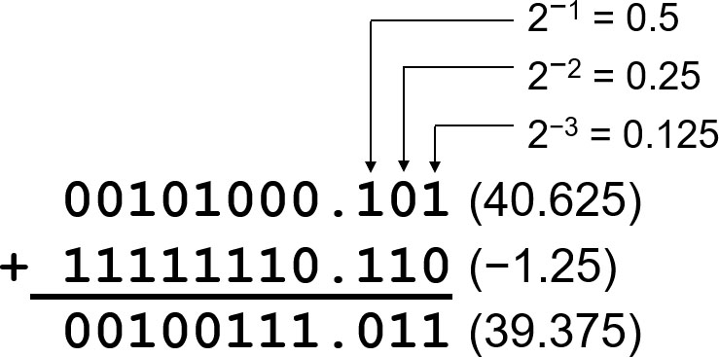
Fractions: Fixed-Point Binary
We use a "binary point" to separate integer bits from fractional bits, just like we use the "decimal point" for decimal numbers.
Two's complement arithmetic still works the same.
NOTE: In a computer, the binary point is implicit -- it is not explicitly represented. We just interpret the values appropriately.

Slide 22
Converting Decimal Fraction to Binary (2's C)
Multiply fraction by 2.
Record one's digit of result, then subtract it from the decimal number.
Continue until you get 0.0000... or you have used the desired number of bits (in which case you have approximated the desired value).
(if limited to 4 fractional bits)

Slide 23
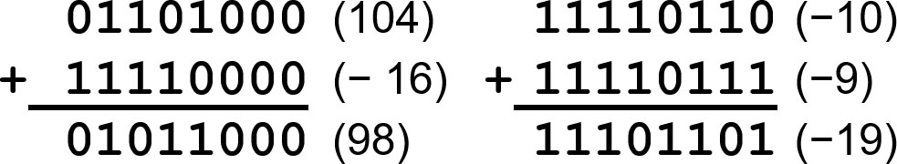
Operation: Addition
As discussed, 2's complement addition is just binary addition.
Assume operands have the same number of bits.
Ignore carry-out.

Slide 24
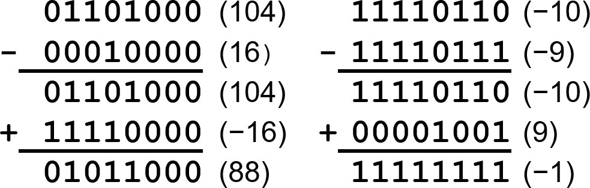
Operation: Subtraction
You can, of course, do subtraction in base-2, but easier to negate the second operand and add.
Again, assume same number of bits, and ignore carry-out.

Slide 25
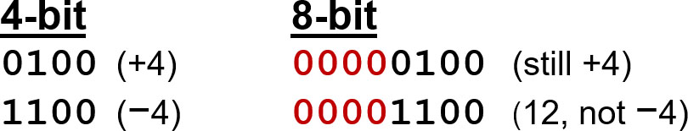
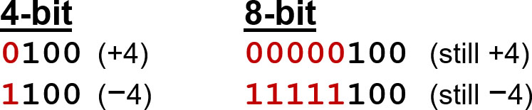
Operation: Sign Extension
To add/subtract, we need both numbers to have the same number of bits. What if one number is smaller?
Padding on the left with zero does not work:
Instead, replicate the most significant bit (the sign bit):

Slide 26
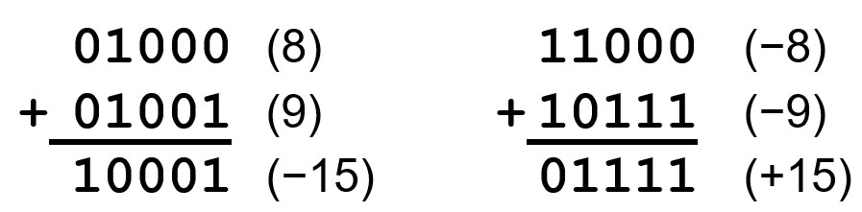
Overflow
If the numbers are two big, then we cannot represent the sum using the same number of bits.
For 2's complement, this can only happen if both numbers are positive or both numbers are negative.
How to test for overflow:
Signs of both operands are the same, AND.
Sign of sum is different.
Another test (easier to perform in hardware): Carry-in to most significant bit position is different than carry-out.

Slide 27
Logical Operations: AND, OR, NOT
If we treat each bit as TRUE (1) or FALSE (0), then we define these logical operations, also known as Boolean operations, on a bit.
A | B | A AND B
0 | 0 | 0
0 | 1 | 0
1 | 0 | 0
1 | 1 | 1
A | B | A OR B
0 | 0 | 0
0 | 1 | 1
1 | 0 | 1
1 | 1 | 1
A | NOT A
0 | 1
1 | 0
View n-bit number as a collection of n logical values (bit vector)
operation applied to each bit independently.

Slide 28
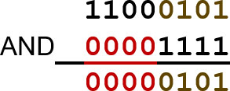
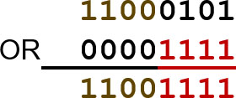

Examples of Logical Operations
AND
useful for clearing bits
AND with zero = 0.
AND with one = no change.
OR
useful for setting bits
OR with zero = no change.
OR with one = 1.
NOT
unary operation -- one argument
flips every bit.

Slide 29
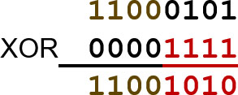
Logical Operation: Exclusive-OR (XOR)
Another useful logical operation is the XOR. True is one of the bits is 1, but not both.
A | B | A XOR B
0 | 0 | 0
0 | 1 | 1
1 | 0 | 1
1 | 1 | 0
XOR
useful for selectively flipping bits
XOR with zero = no change.
XOR with one = flip.

Slide 30
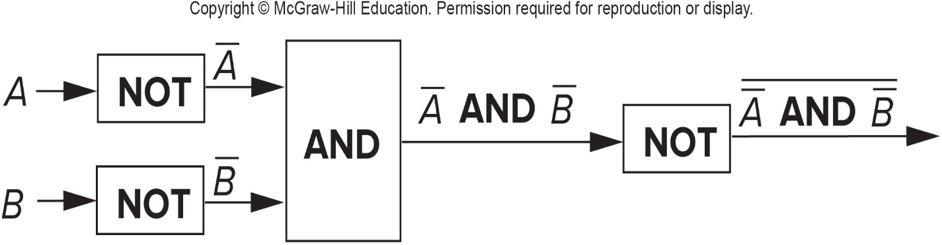
DeMorgan's Laws 1
There's an interesting relationship between AND and OR.
If we NOT two values (A and B), AND them, and then NOT the result, we get the same result as an OR operation. (In the figure below, an overbar denotes the NOT operation.)
Here's the truth table to convince you:
Copyright © McGraw Hill Education. Permission required or display
A | B | A̅ | B̅ | A̅ AND B̅ | A̅ AND B̅
0 | 0 | 1 | 1 | 1 | 0
0 | 1 | 1 | 0 | 0 | 1
1 | 0 | 0 | 1 | 0 | 1
1 | 1 | 0 | 0 | 0 | 1

Slide 31
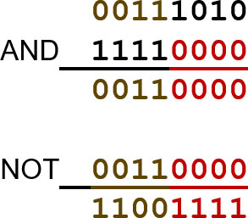

DeMorgan's Laws 2
This means that any OR operation can be written as a combination of AND and NOT.
This is interesting, but is it useful? We'll come back to this in later chapters...
Also, convince yourself that a similar "trick" works to perform AND using only OR and NOT.

Slide 32

Very Large or Very Small Numbers: Floating-Point
Large values:
-- requires 79 bits
Small values:
-- requires >110 bits
Range requires lots of bits, but only four decimal digits of precision.
Use a different encoding for the equivalent of “scientific notation”: F × 2E
Need to represent F (fraction), E (exponent), and sign.
I E E E 754 Floating-Point Standard (32-bits):

Slide 33
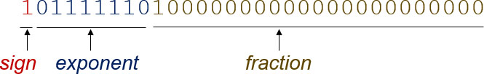
Floating-point Example
Single-precision I E E E floating point number:
Sign is 1 – number is negative.
Exponent field is 01111110 = 126 (decimal).
Fraction is 0.100000000000… = 0.5 (decimal).

Slide 34
Converting from Decimal to Floating-Point Binary
How do we represent
as a floating-point binary number?
Ignoring sign, represent as a binary fraction: 0110.101
Next, normalize the number, by moving the binary point to the right of the most significant bit:
Exponent field = 127 + 2 = 129 = 10000001
Fraction field = everything to the right of the binary point: 101010000....
Sign field is 1 (because the number is negative).
Answer:
11000000110101000000000000000000

Slide 35
Special Values
Infinity
If exponent field is 11111111, the number represents infinity.
Can be positive or negative (per sign bit).
Subnormal
If exponent field is 00000000, the number is not normalized. This means that the implicit 1 is not present before the binary point. The exponent is −126.
Extends the range into very small numbers.
Example: 00000000000001000000000000000000.

Slide 36
Representing Text: A S C I I Code
To represent other types of data, such as text, we devise various coding schemes.
A S C I I is a 7-bit code representing basic letters, digits, punctuation,... A portion of the A S C I I table is shown below.
7b binary | character | 7b binary | character
011 0000 | 0 | 0101 | E
011 0001 | 1 | 110 0101 | e
010 0001 | ! | 010 0000 | space
010 0011 | # | 000 1010 | linefeed
See complete table in Appendix E.

Slide 37
Hexadecimal Notation: Binary Shorthand
To avoid writing long (error-prone) binary values, group four bits together to make a base-16 digit. Use A to F to represent values 10 to 15.
binary (base 2) | hexadecimal (base 16) | decimal (base 10)
0000 | 0 | 0
0001 | 1 | 1
0010 | 2 | 2
0011 | 3 | 3
0100 | 4 | 4
0101 | 5 | 5
0110 | 6 | 6
0111 | 7 | 7
binary (base 2) | hexadecimal (base 16) | decimal (base 10)
1000 | 8 | 8
1001 | 9 | 9
1010 | A | 10
1011 | B | 11
1100 | C | 12
1101 | D | 13
1110 | E | 15
1111 | F | 15
Ex: Hex number 3 D 6 E easier to communicate than binary 0011110101101110.

Slide 38
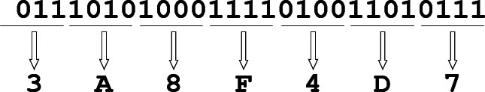
Converting from binary to hex
Starting from the right, group every four bits together into a hex digit. Sign-extend as needed.
This is not a new machine representation or data type, just a convenient way to write the number.

